Slide 2
NEURON: Neuron is known to have based its foundation on delivering quality products and services. Winning the hearts of lakhs across the nation and have been established as a marker of quality, Neuron is the hallmark of trust.
With our commitment and ethos coupled with hardcore advantages of infrastructure, hygienic industry and good quality product, Neuron pledges to be a trusted, reliable and industry recognized partner to you and your business. A company you can rely on. We pledge to provide penetrating prices and exceptionally good value to our customers at all times.

Slide 3
QUALITY
Neuron Industries is certified for ISO 9001:2015 (Quality Management System).
Customer Satisfaction and Quality are major priorities of Neuron Industries.

Slide 4
NEURON PRIME
Neuron Prime is a vast range of exceptional beauty equipments.
The range consists nine products- 4 wax heaters, 2 Steamers, 1 Oil Warmer and 2 Sterilizers.
Its launch is expected to release path breaking sales attributing to its quality and appearance.
Prime Range is available online at e- portals like Amazon and Flipkart.

Slide 5
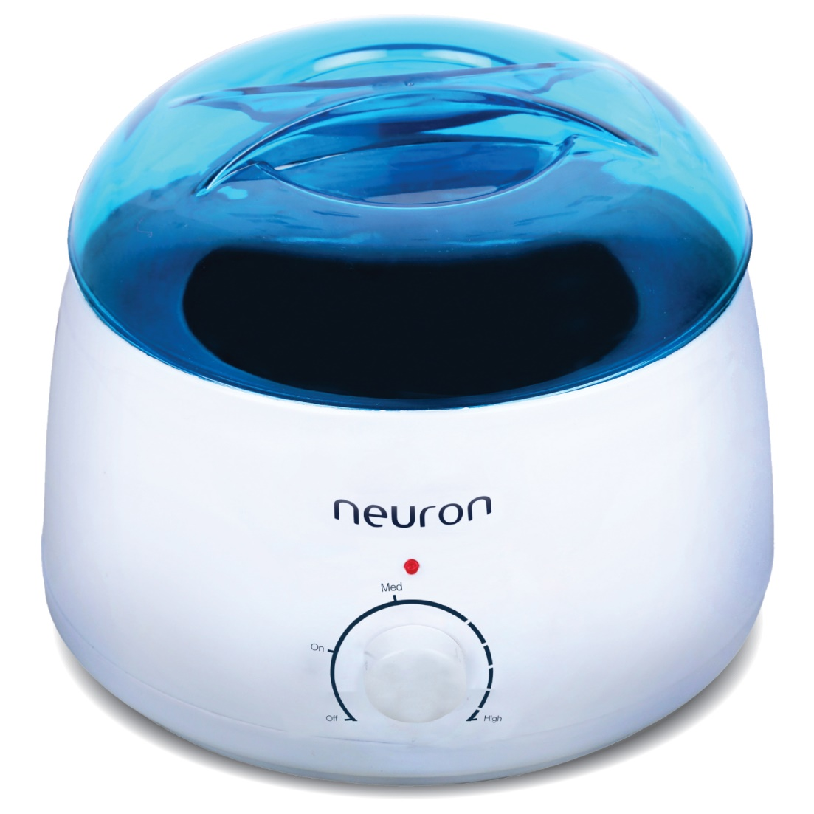
MERCURY WAX HEATER
International quality
Big size container
Fuse for safety
Heat resistant plastic body
Shock proof
Heat regulator
On/off indicator
Unbreakable body
Energy saver
MRP : Rs 685

Slide 6
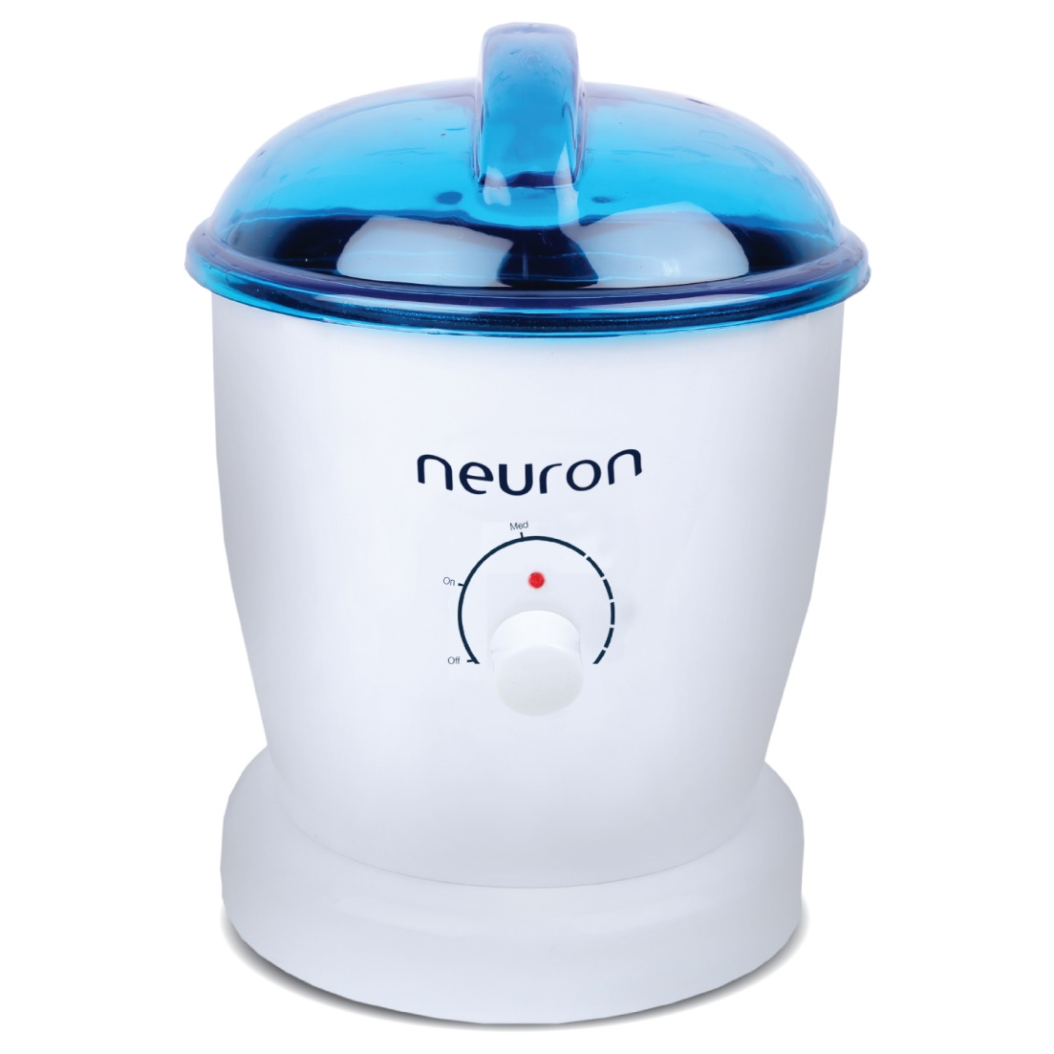
MARS WAX HEATER
International quality
Big size container
Fuse for safety
Heat resistant plastic body
Shock proof
Heat regulator
On/off indicator
Unbreakable body
Energy saver
MRP : Rs 767

Slide 7
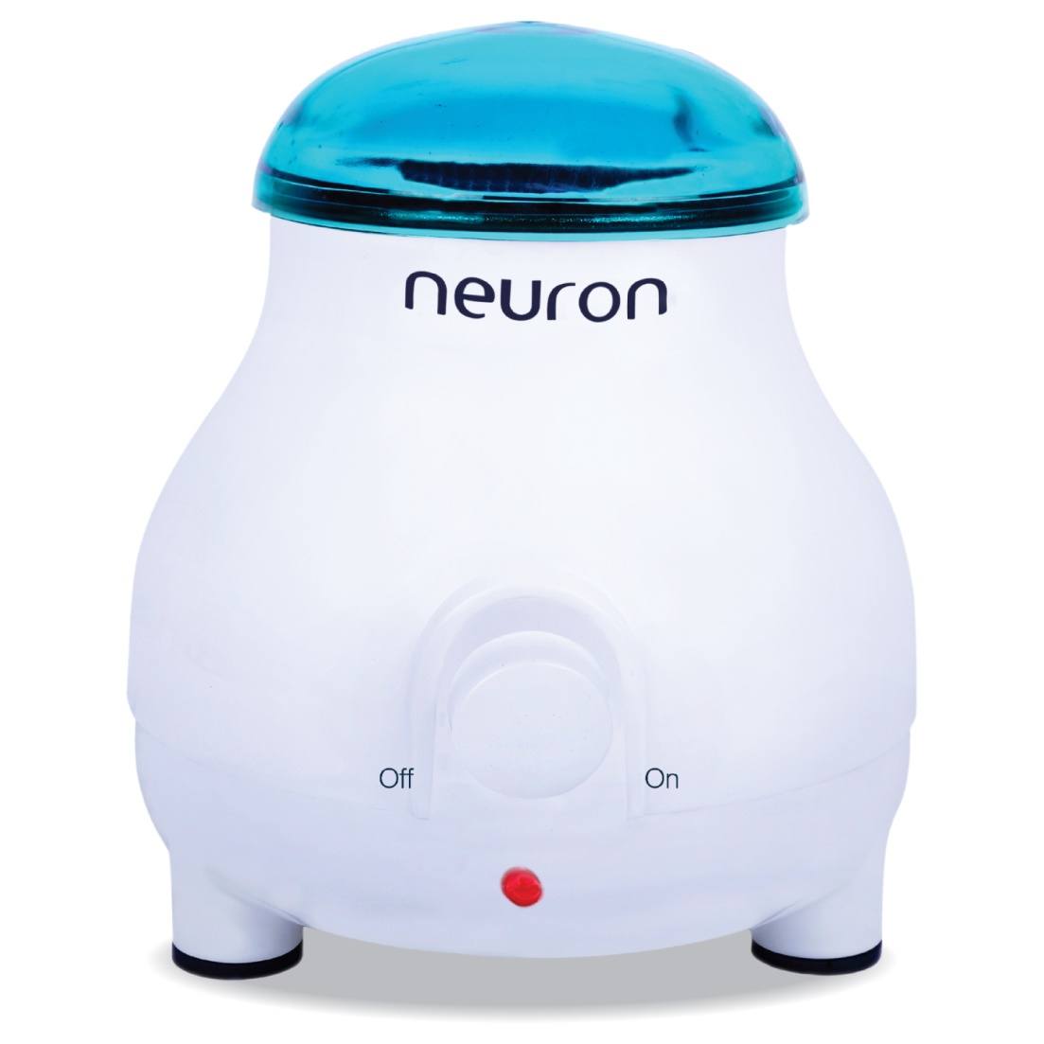
JUPITER WAX HEATER
International quality
Big size container
Fuse for safety
Heat resistant plastic body
Shock proof
Heat regulator
On/off indicator
Unbreakable body
Energy saver
MRP : Rs 840

Slide 8
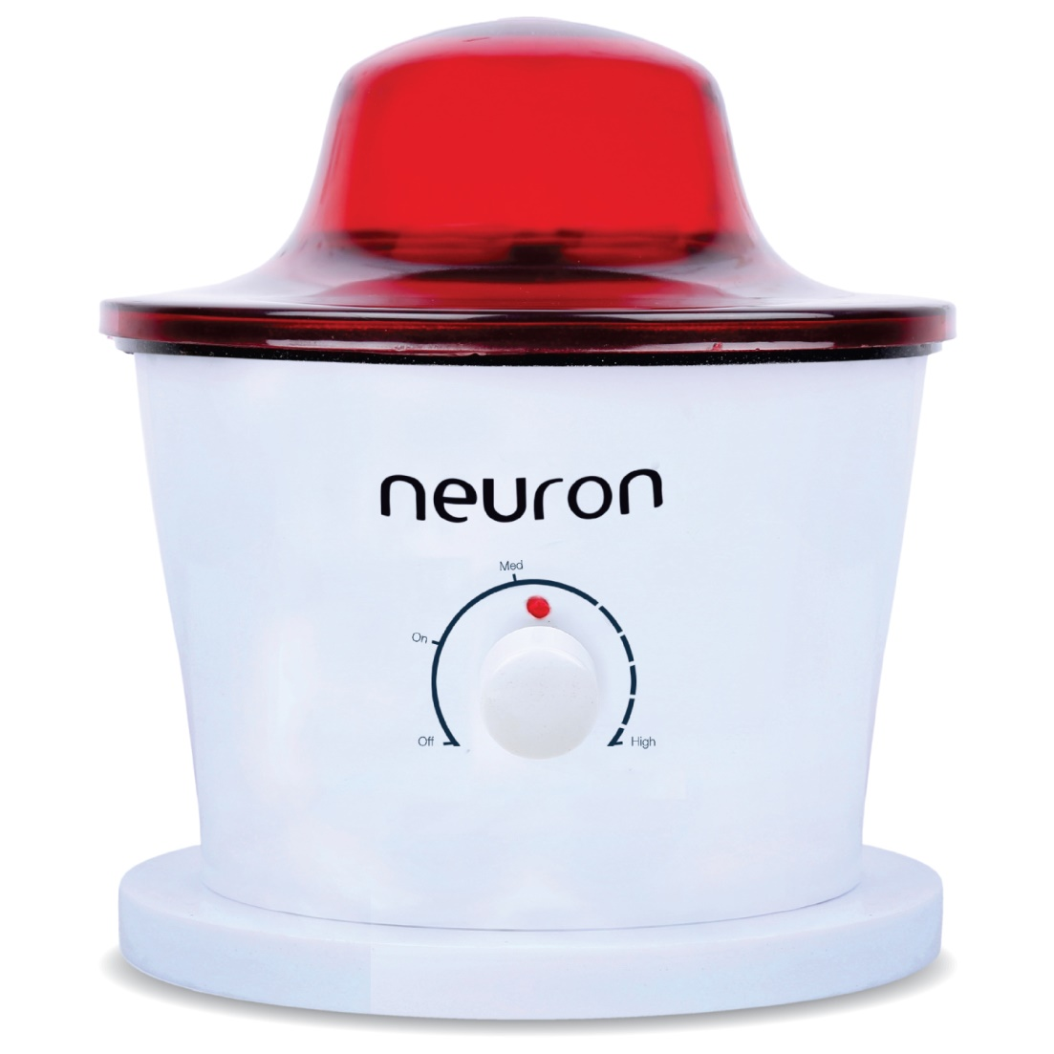
PLUTO WAX HEATER
International quality
Big size container
Fuse for safety
Heat resistant plastic body
Shock proof
Heat regulator
On/off indicator
Unbreakable body
Energy saver
MRP : Rs 592

Slide 9
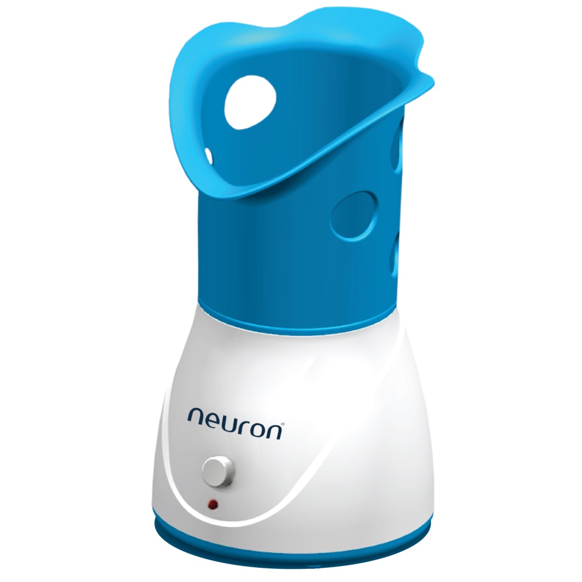
ALPHA STEAMER
International quality
Food grade container used
Heat resistant plastic body
Shock proof
Heat regulator
On/off indicator
Unbreakable body
Energy saver
MRP : Rs 695

Slide 10
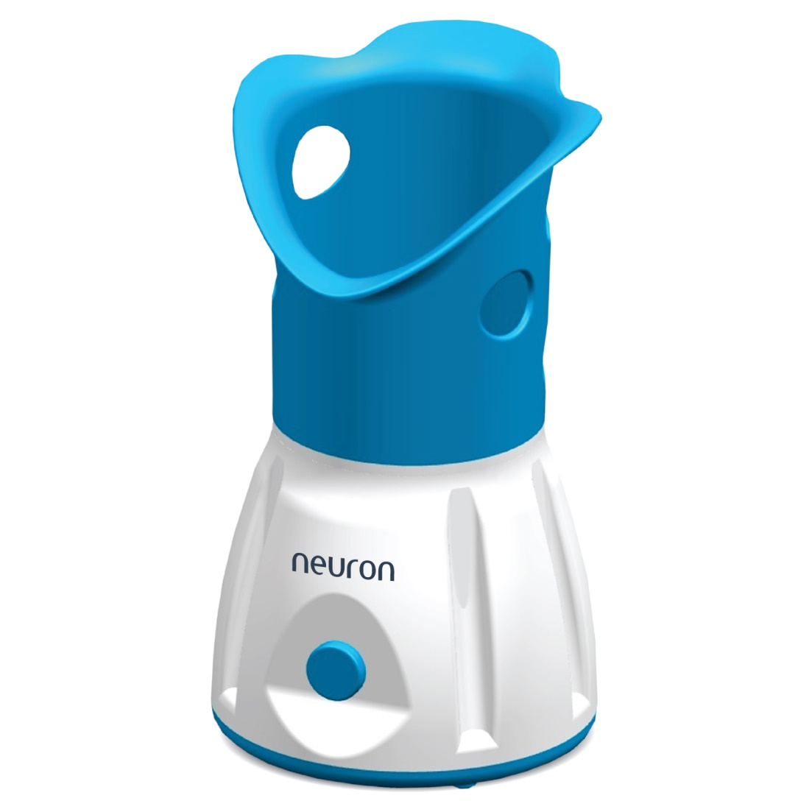
BETA STEAMER
International quality
Food grade container used
Heat resistant plastic body
Shock proof
Heat regulator
On/off indicator
Unbreakable body
Energy saver
MRP : Rs 720

Slide 11
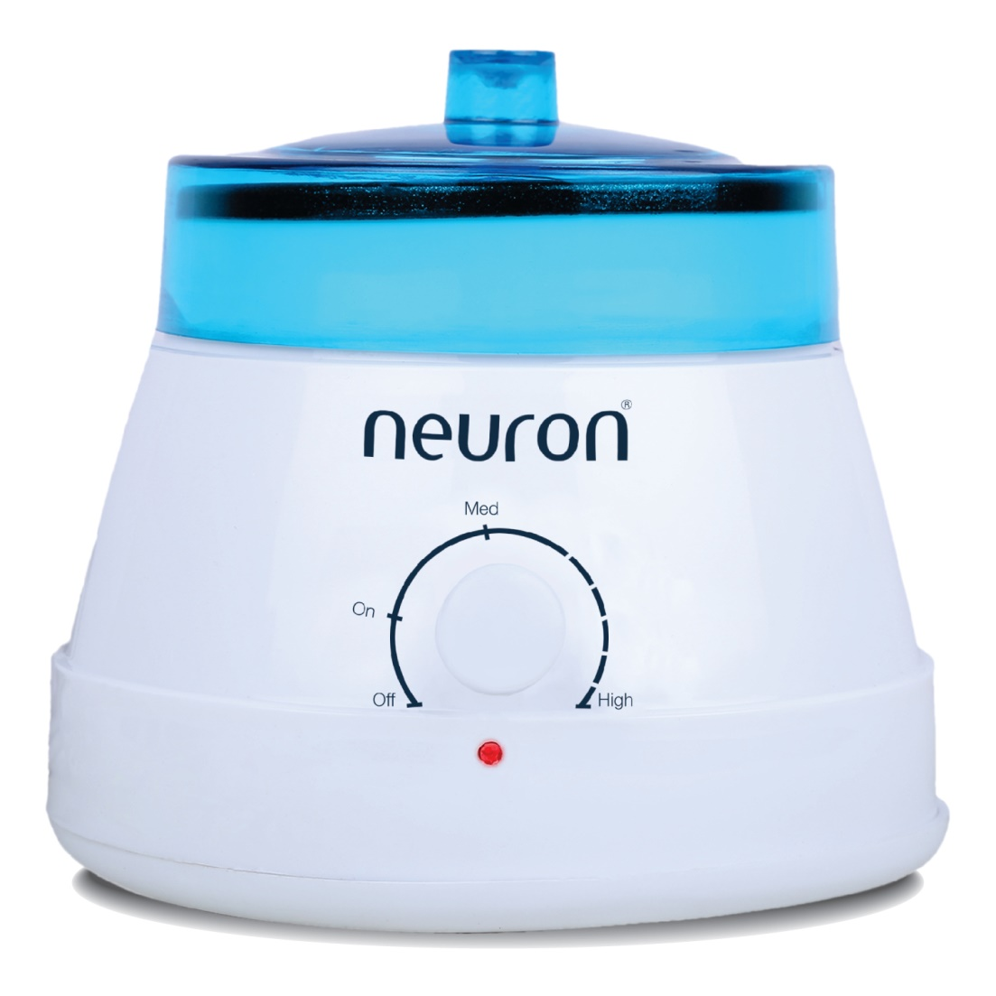
OIL WARMER
International quality
Fully automatic
Fuse for safety
Heat resistant plastic body
Shock proof
Heat regulator
On/off indicator
Unbreakable body
Energy saver
MRP : Rs 479

Slide 12
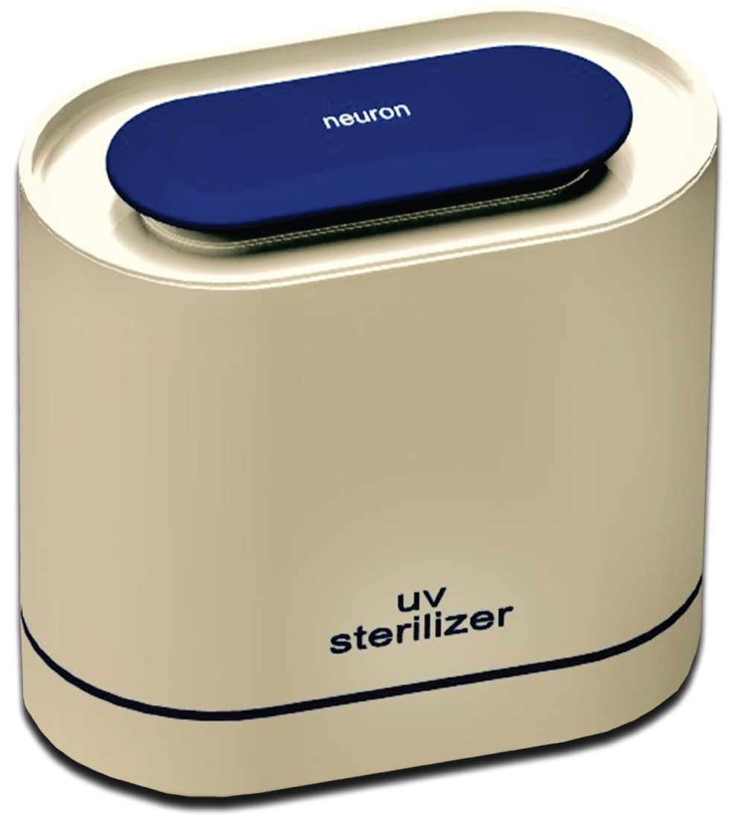
S1 UV STERILIZER
Phillips UV tube and ballast used
International design
Light weight plastic body
Three step switch
15 min sterilization process
On/off indicator
Unbreakable body
Portable
MRP : Rs 3473

Slide 13
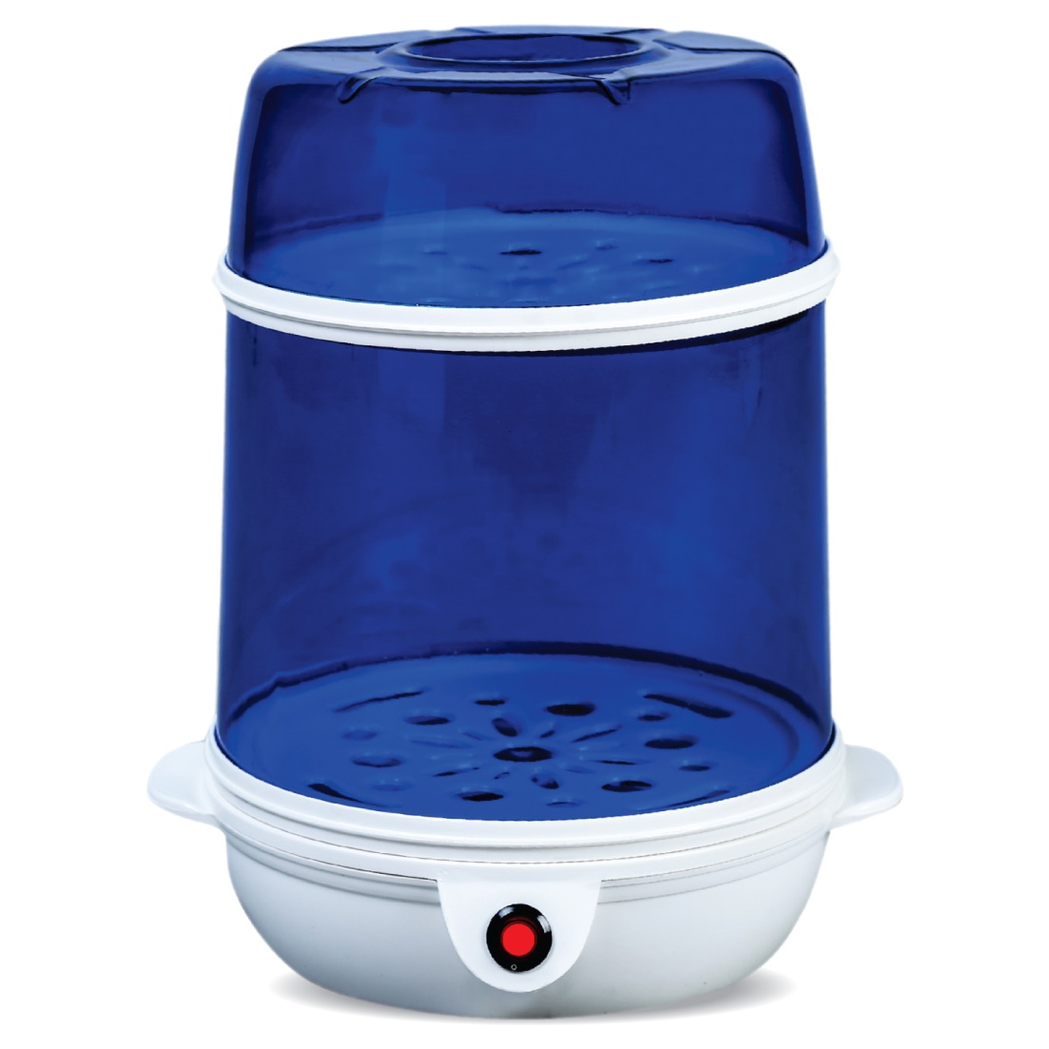
S2 UV STERILIZER
Phillips UV tube and ballast used
TWO-in-ONE convertible
International design
Light weight plastic body
15 min sterilization process
On/off indicator
Unbreakable body
Portable
MRP : Rs 3957

Slide 14
WHY NEURON PRIME?
European Standard products
Temperature regulators
Fuse for safety point of view
Expansive range
Good service facility
Upgraded technology
Finest material used

Slide 15
CONTACT US AT:
1800 120 5955
(Toll Free Customer Care)

